Slide 1
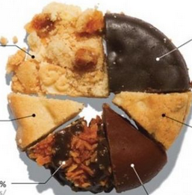
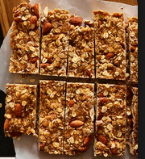
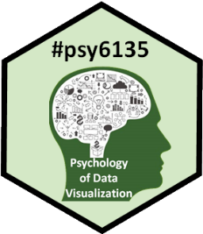
Deep Questions of Data Visualization
Michael Friendly
Psych 6135
https://friendly.github.io/6135

Slide 2
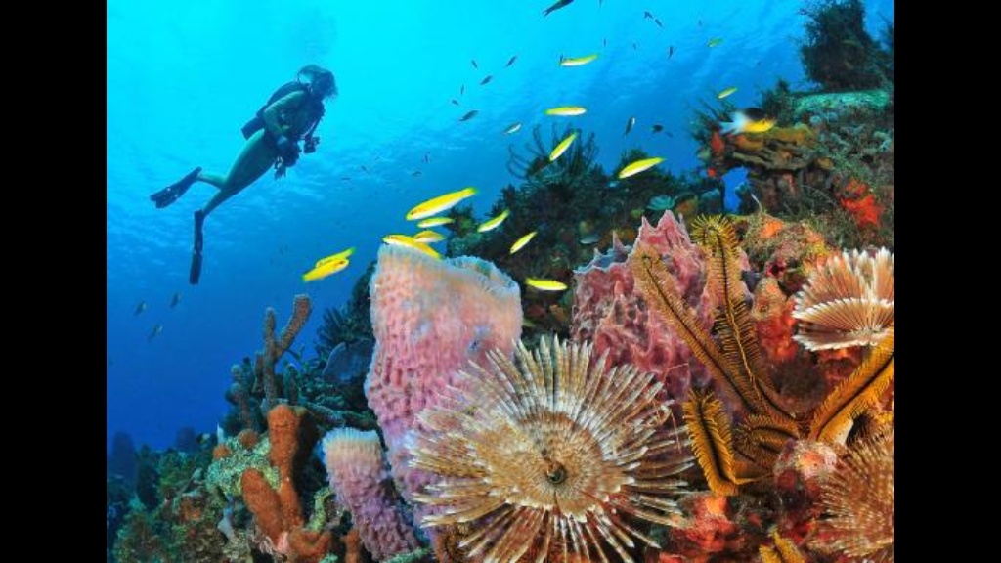
While you were enjoying a relaxing week without classes, I was working hard, pondering the:
Deep questions of data visualization

Slide 3
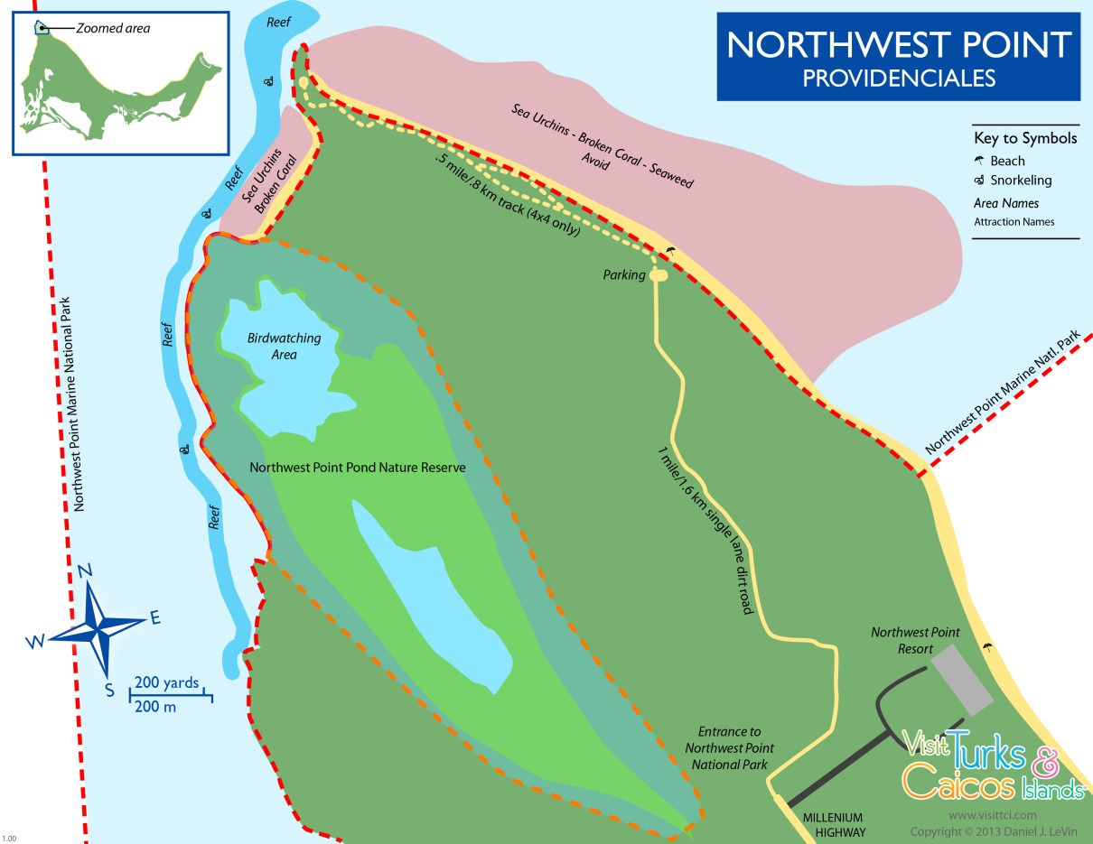
The Deep Question Research Institute,
NorthWest Point, Providenciales, Turks & Caicos
The Wall (6000’)
The first scientific study of graphical preference among marine animals!

Slide 4

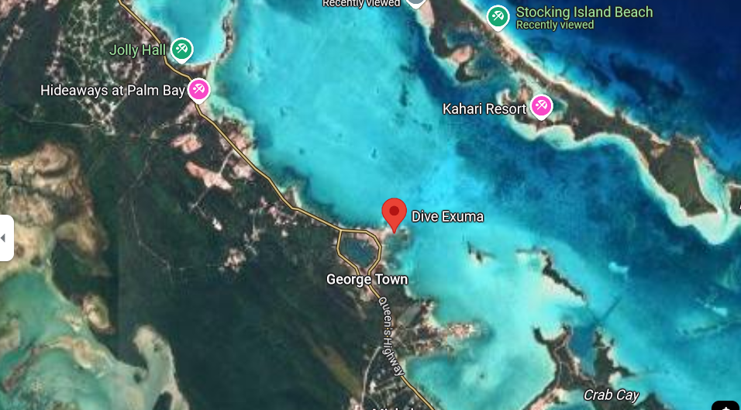
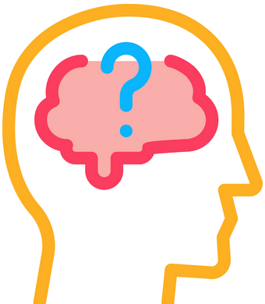
Deep Questions Research Institute
Great Exuma, Bahamas
How to study graph preference in marine animals?

Slide 5
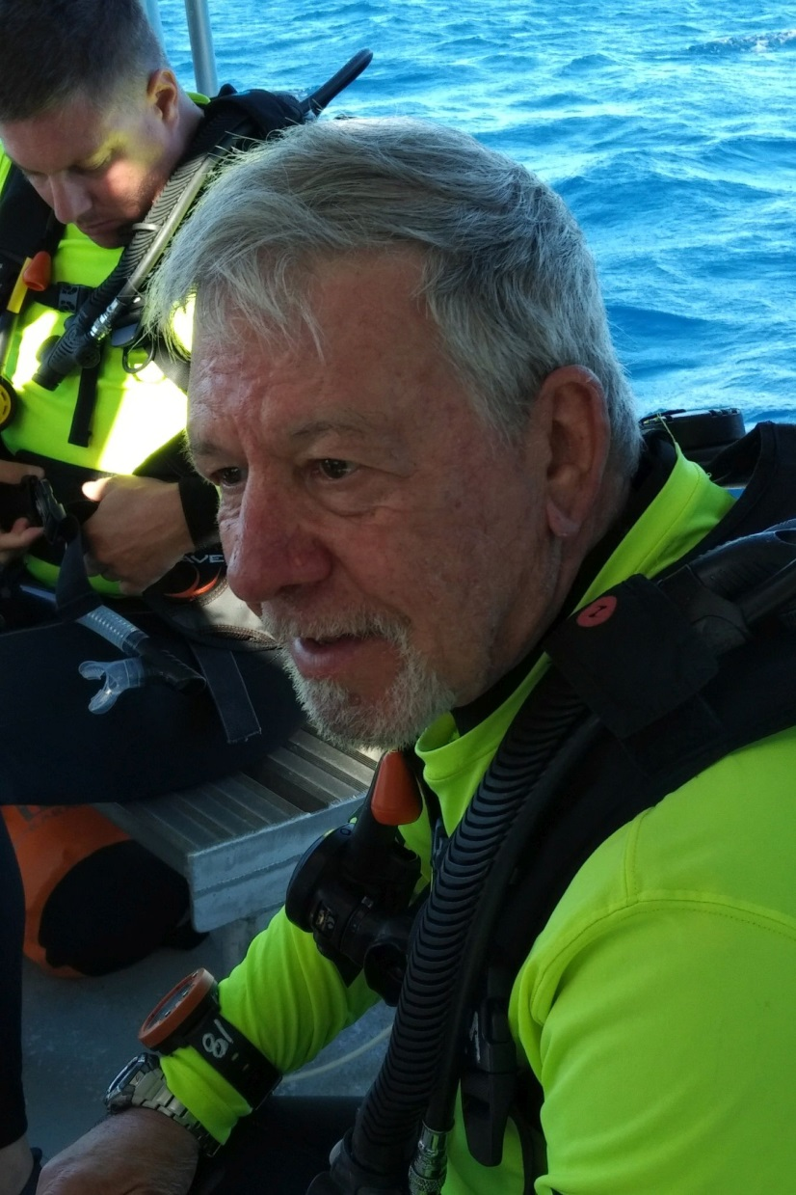
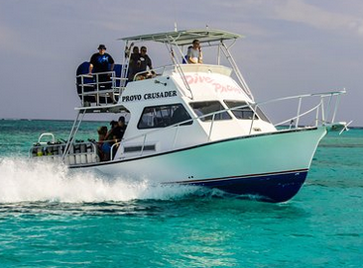
Research team* aboard the MV Playfair
Divers suit up
MV Playfair
* Thanks for technical assistance from Dive Exuma

Slide 6


Shark experiment: Pies vs. Bars
Do sharks prefer conch pie charts or granola bar charts?
Design: Two-alternative forced-choice, n=50 trials
Conch pie
Granola bar
Sample stimulus items

Slide 7
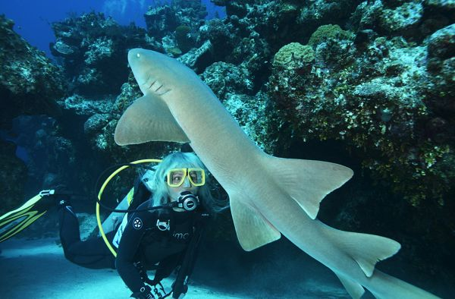
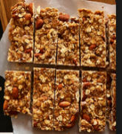
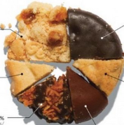
Shark experiment
One experimental trial:
??

Slide 8
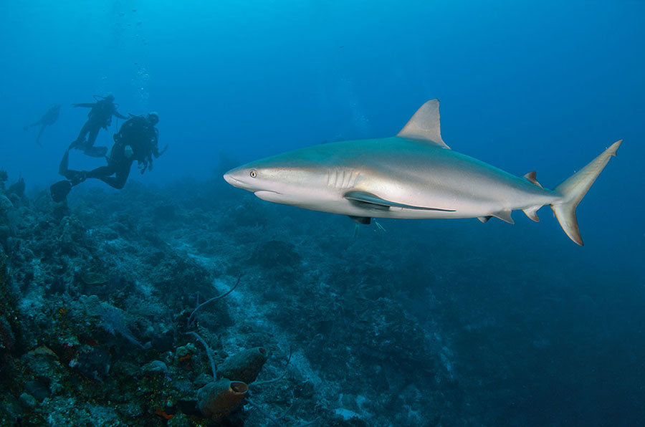
Shark experiment: Pies vs. Bars
Results: Sharks show an overwhelming preference for conch pie
Choice | n
Pie | 45
Bar | 4
Diver * | 1
??
* Ethics disclosure: All divers were volunteers. None were consumed in this experiment.

Slide 9
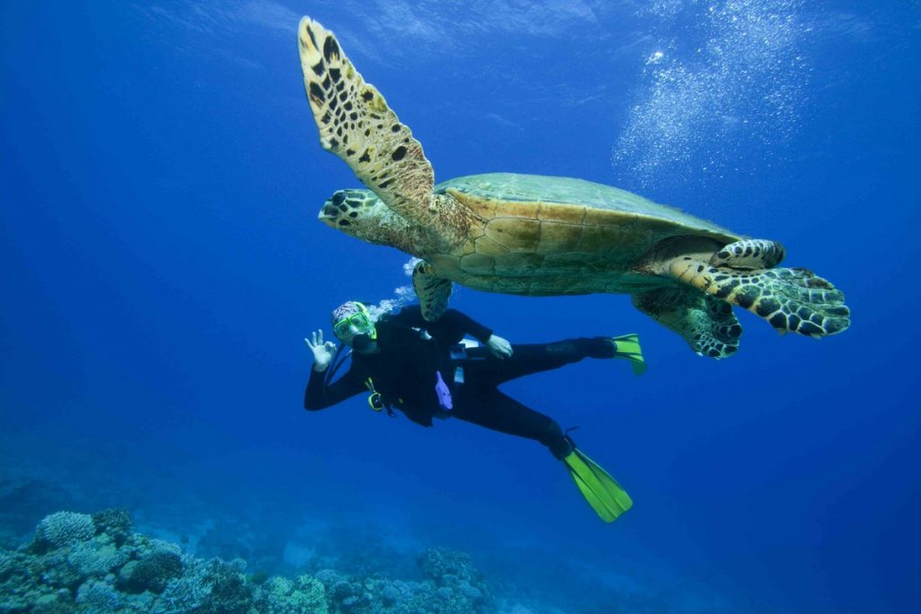
Turtle experiment
Does this generalize? What about turtles?
Results: Turtles show an overwhelming preference for granola bar charts
Choice | n
Pie | 3
Bar | 47
Diver | 0
??

Slide 10
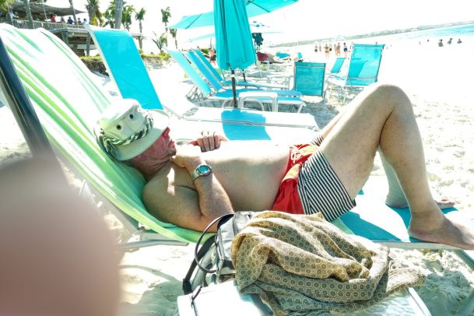
Visualizing the results
Successful visualizations require some time for reflection

Slide 11
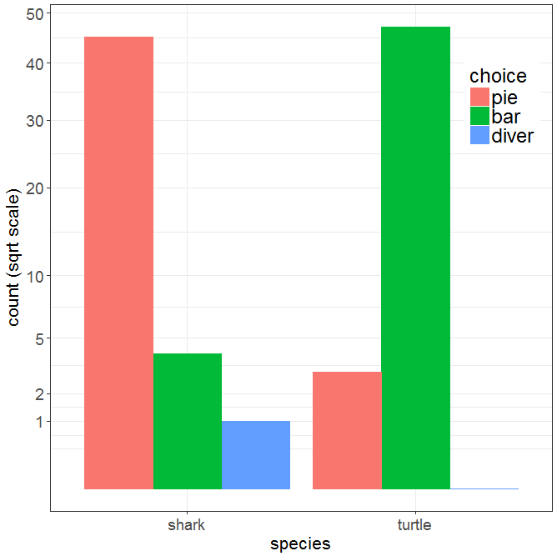
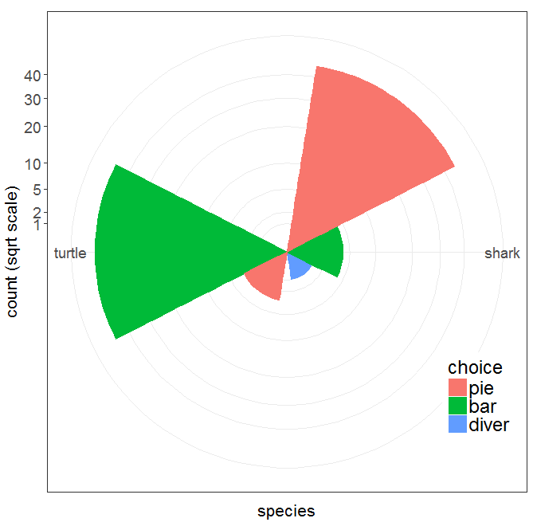
Visualizing the results
Bar chart
Windrose = bar chart + polar coords
Which do you prefer? Is there something better before I publish this?

Slide 12
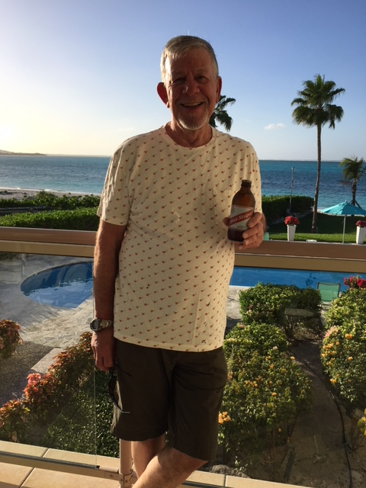

The Red Stripe Award
The research reported* here was given the February 2024 Red Stripe Award by the Deep Question Research Institute
* This research was not supported by the National Sciences and Engineering Research Council of Canada

Slide 13
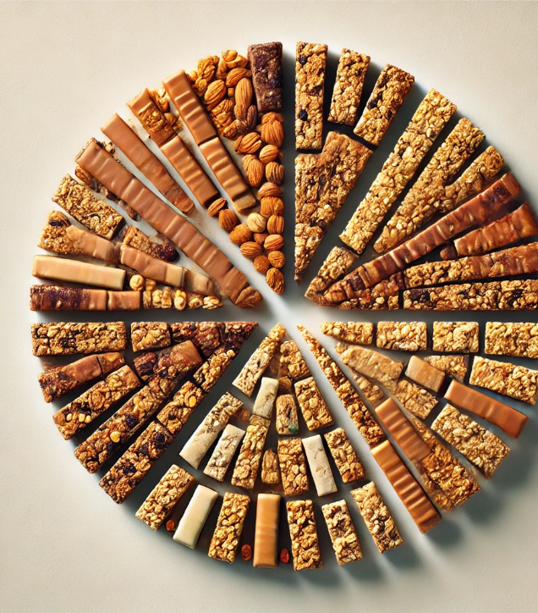
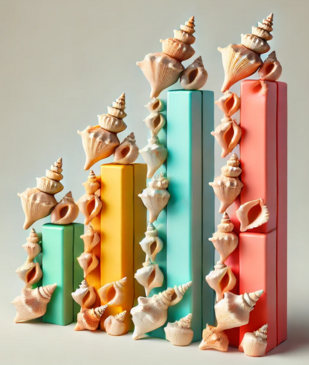
Further research
Include the obvious and necessary control conditions in a 2 x 2 factorial design (chart type × food type):
conch bar charts vs. conch pie charts
granola pie charts vs. granola bar charts

Slide 14

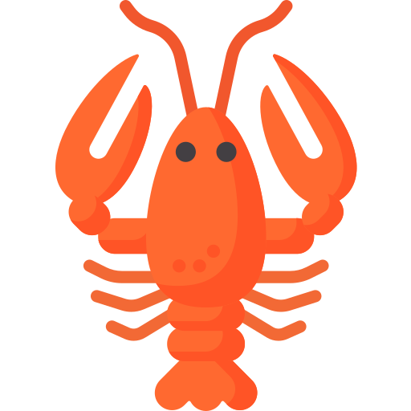
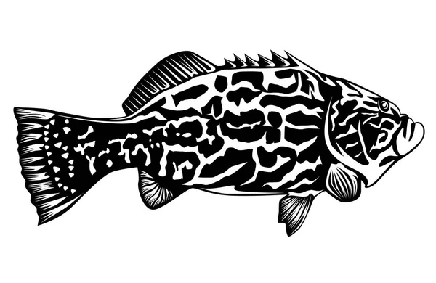
Further research
Extend this to another species:
dolphins: known to be much smarter than sharks and turtles; is graphical preference related to intelligence?
parrot fish, groupers, lobsters: what can we do??
Investigate influence of color on graph preference
This can be also be studied as a function of depth, because colors become more muted at greater depth

